Slide 1

Indian Institute of Science Education and Research Bhopal
DATA SCIENCE IN PRACTICE PROJECT PRESENTATION
Geospatial Analysis of Earthquake Data
Kunwar Arpit Singh, 22185
Ankush Prakash, 22043
Samba Siva Reddy T, 22276
Rudra Baunk, 22268
Presented By:

Slide 2





INTRODUCTION
Data Science in Practice Project
Goal: Analyze global earthquake data to identify spatial trends, clusters, and build a model to classify magnitude categories.
Key Components:
Data Cleaning and Preprocessing
Exploratory Data Analysis
Geospatial and interactive visualizations
K-Means clustering
Machine Learning Classification Model

Slide 3

PROJECT OBJECTIVES
Data Science in Practice Project
We aim to use data visualization and ML methods to:
01
Study magnitude and depth distributions to understand how earthquakes vary in size and origin.
02
Analyze global epicenter locations to reveal spatial patterns in seismic activity.
03
Use clustering to uncover natural groupings of earthquakes based on their characteristics.
04
Build a model that predicts an earthquake’s magnitude category from its geospatial features.

Slide 4

DATASET DESCRIPTION
Data Science in Practice Project
Source: Global earthquake data (1965–2016)
Total Entries: 23,412
Features: 21 columns including date, time, latitude, longitude, depth, magnitude, and event type
Key Columns Used:
• Latitude
• Longitude
• Magnitude
• Depth
• Type

Slide 5
Data Science in Practice Project
DATA CLEANING & PREPROCESSING
Steps performed:
Data Description
Reduced entries: 23,412 → 23,232
Combined Date + Time into a DateTime feature
Prepared data for EDA, clustering, and modeling
Removed rows with missing latitude, longitude, magnitude, or depth
Filtered only natural earthquakes
EXPLORATORY DATA ANALYSIS
EDA focused on:
• Magnitude distribution
• Depth–Magnitude Relationship
• Global Epicenter Distribution
These helped understand seismic patterns and identify hotspots

Slide 6

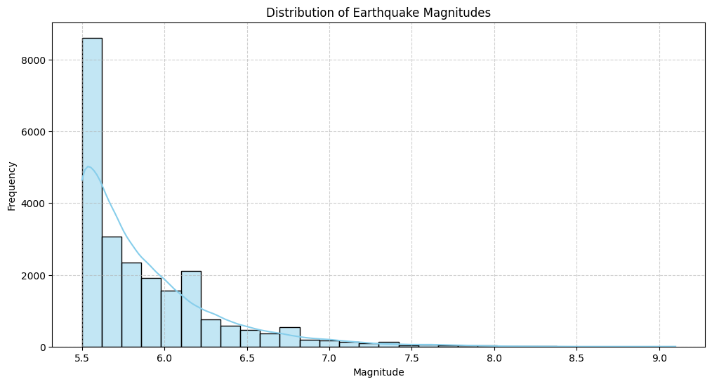
EDA:
Data Science in Practice Project
MAGNITUDE DISTRIBUTION
Observations:
Most earthquakes have low magnitudes
Frequency drops exponentially as magnitude increases
Matches the Gutenberg–Richter law
Strong indicator of class imbalance for modeling

Slide 7

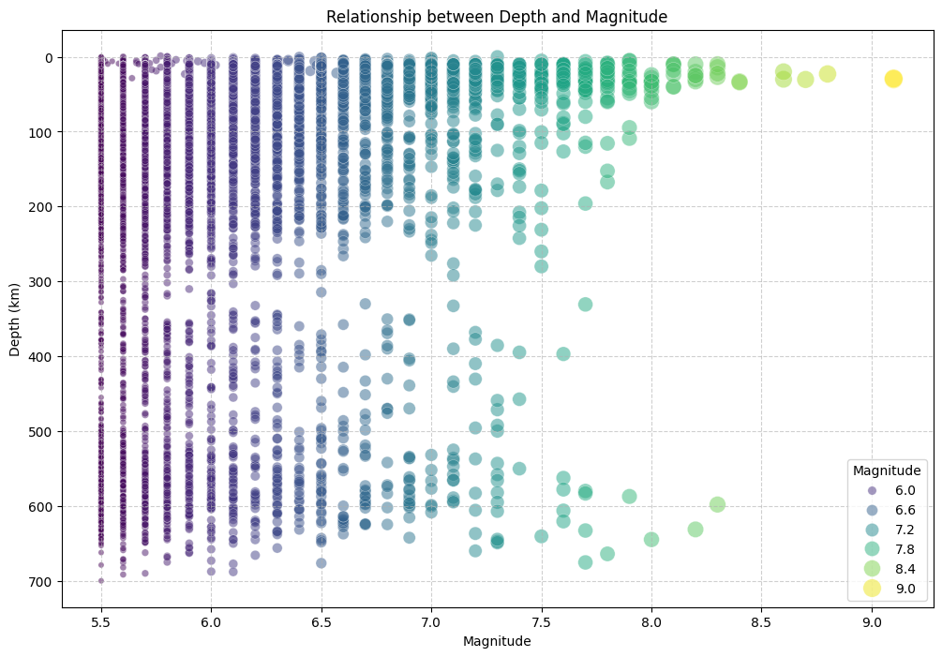
EDA:
Data Science in Practice Project
DEPTH VS. MAGNITUDE
Observations:
Majority of earthquakes are shallow (<100 km)
High-magnitude events occur across depths
No clear linear correlation between magnitude and depth

Slide 8
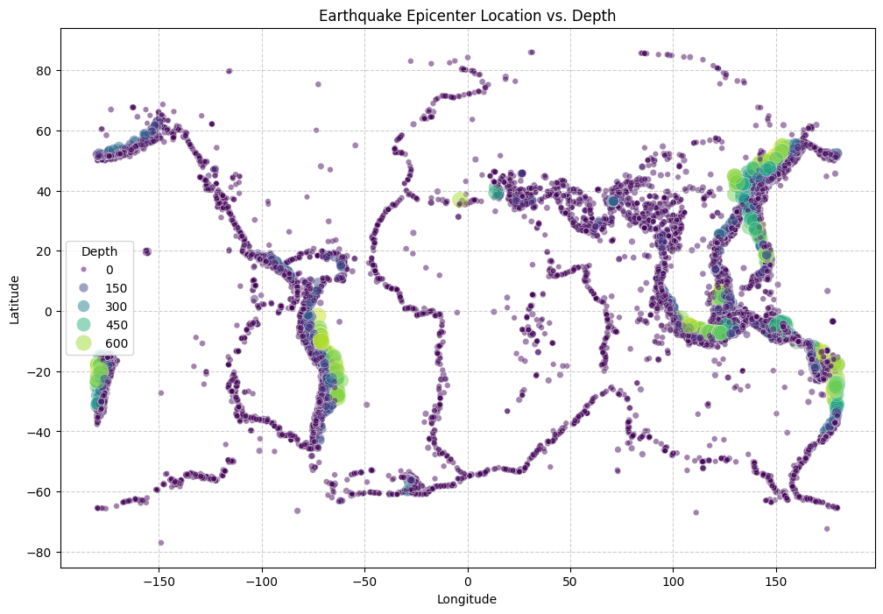
EDA:
Data Science in Practice Project
GLOBAL EPICENTER DISTRIBUTION
Insights:
Earthquake epicenters outline tectonic plate boundaries
Highest activity around the Pacific Ring of Fire
Strong clustering in Japan, Southeast Asia, Western Americas

Slide 9
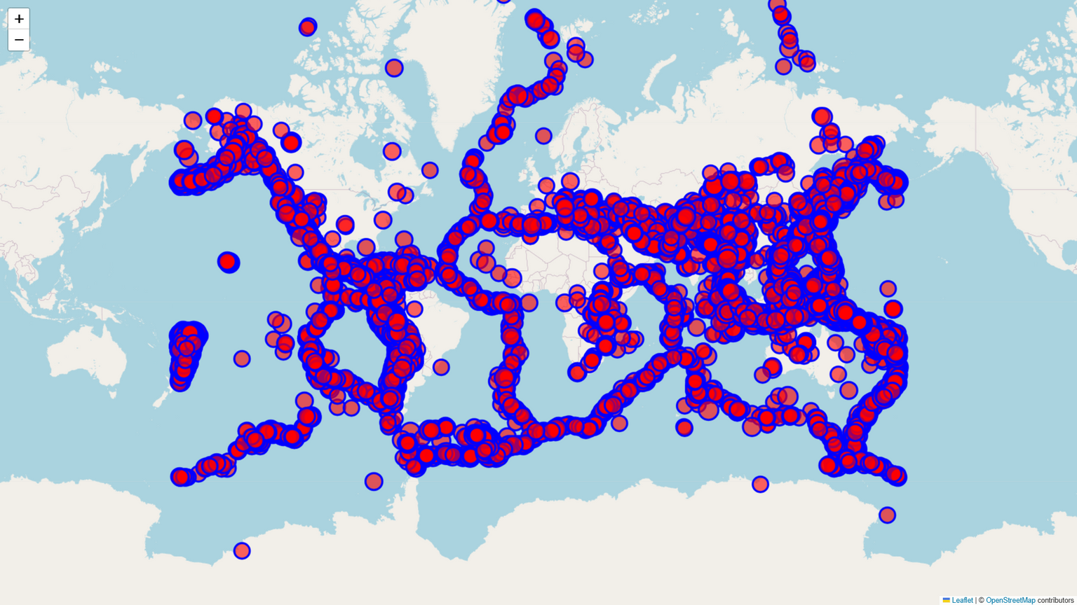
EDA:
Data Science in Practice Project
INTERACTIVE VISUALIZATION
Explanation:
Built using Folium:
Interactive scatter maps
Circle radius proportional to magnitude
Depth and magnitude shown on hover
Helps explore exact locations of major events

Slide 10
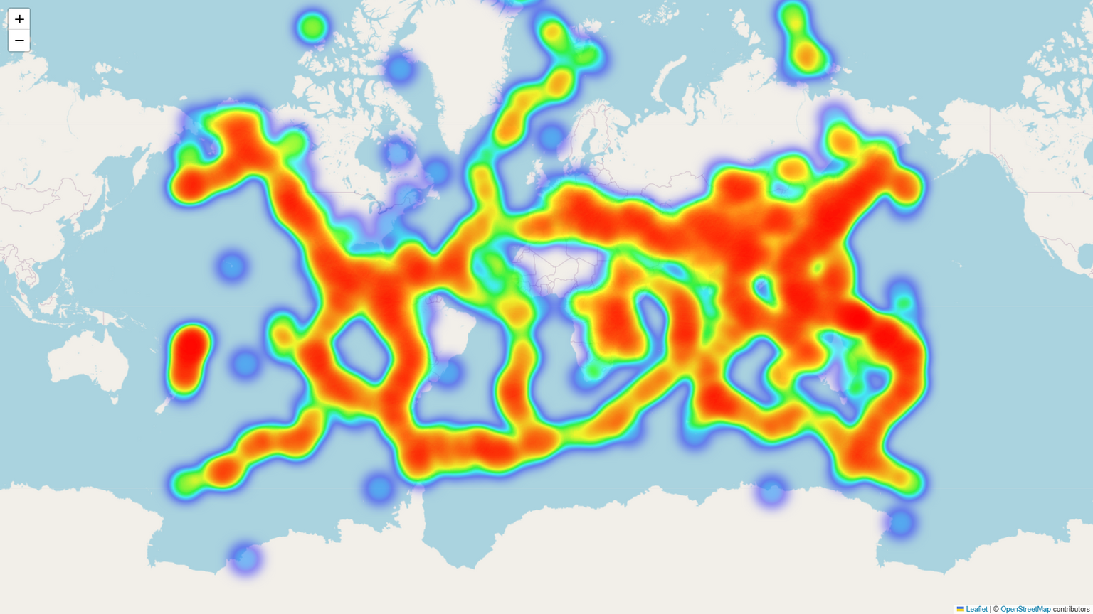
EDA:
Data Science in Practice Project
HEATMAP VISUALIZATION
Purpose:
Highlight regions with dense seismic activity
Result:
Pacific Ring of Fire is the hottest zone
Eurasian plate belt also prominent
Useful for risk visualization

Slide 11
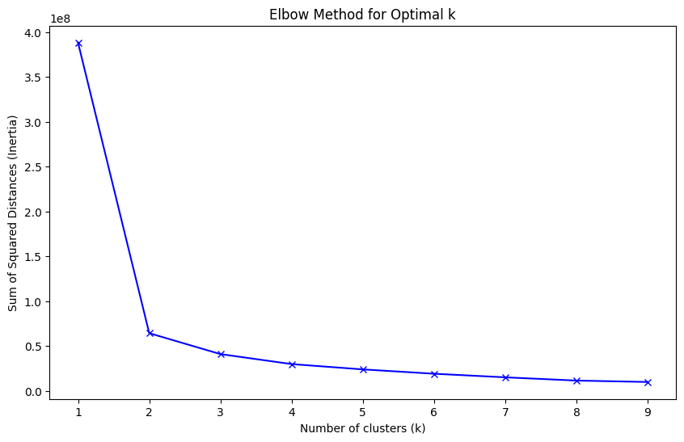
CLUSTERING WITH K-MEANS
Data Science in Practice Project
Objective:
Identify natural patterns using Latitude, Longitude, Magnitude
Method:
Used Elbow Method to determine optimal K
Compared inertia values for K = 1–10
OPTIMAL K SELECTION
Result:
Clear elbow at K = 4
Balanced complexity and intra-cluster variance

Slide 12
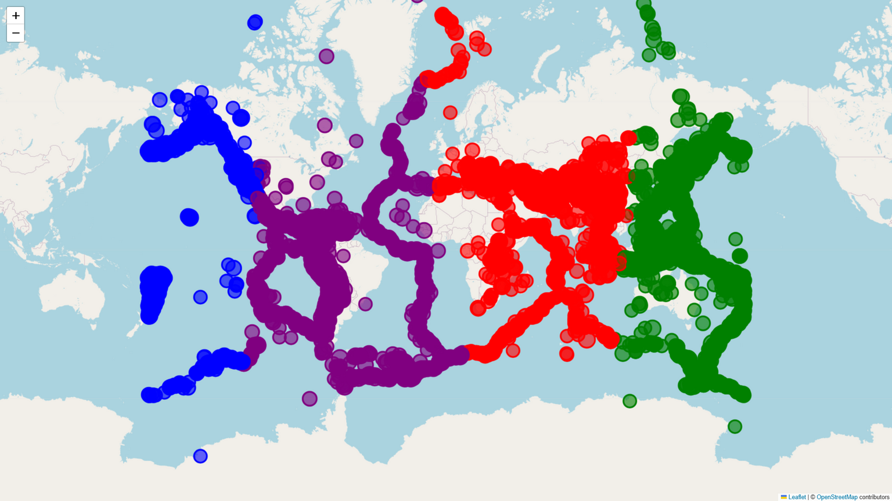
CLUSTER INTERPRETATION
Data Science in Practice Project
The four clusters align with major tectonic zones:
Cluster 0:
Pacific coast of the Americas
Cluster 1:
Western Pacific and Oceania
Cluster 2:
Eurasian plate boundary (Alpide belt)
Cluster 3:
Mid-ocean ridges and diffuse zones

Slide 13
PREDICTIVE MODELING
Data Science in Practice Project
Goal:
Features used:
Predict magnitude category:
• Low: <5.0
• Medium: 5.0–7.0
• High: ≥7.0
Depth
Latitude
Longitude
Train-test split: 80–20, stratified.
CLASS DISTRIBUTION
After preprocessing:
• Medium: 22,494
• High: 738
• Low: 0 (none remain after filtering)
Severe imbalance affects model learning.

Slide 14
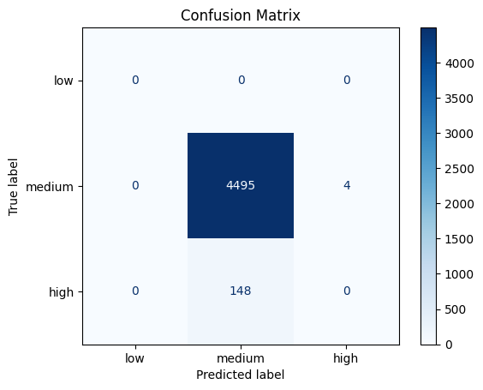
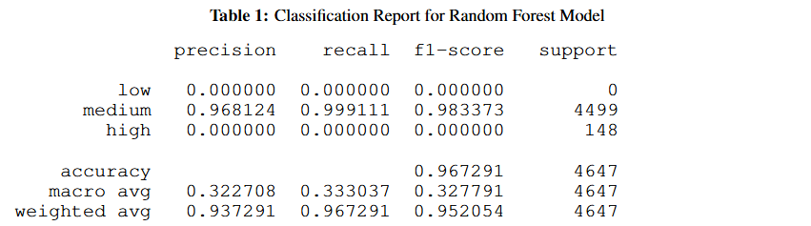
Data Science in Practice Project
BASELINE RANDOM FOREST MODEL
Baseline Performance:
Interpretation:
Accuracy: 96.73%
Accuracy is misleading due to imbalance.
Model predicts medium class extremely well
Completely fails to identify high-magnitude earthquakes
No low-magnitude examples in test set
Need better handling of rare events

Slide 15
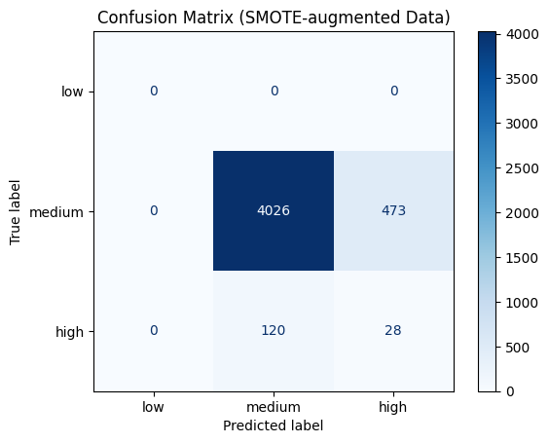
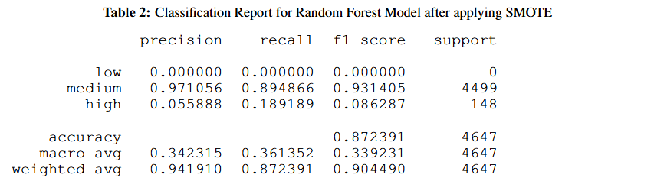
Data Science in Practice Project
IMPROVING IMBALANCE WITH SMOTE
SMOTE is applied to training data:
Medium: 17,995 → 17,995
• High: 590 → 17,995 (synthetically balanced)
Accuracy: 87.24%
Interpretation:
The model now detects some high-magnitude earthquakes
Precision for high class remains low due to oversampling
Medium class performance drops slightly
Overall accuracy decreases, but high-class learning improves
Trade-off: Better minority detection vs. Overall Accuracy.

Slide 16
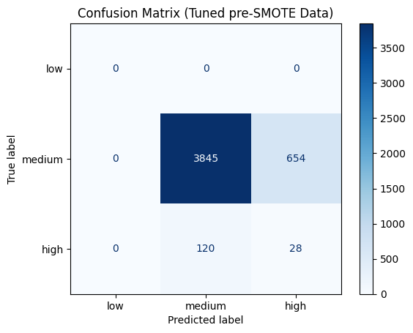
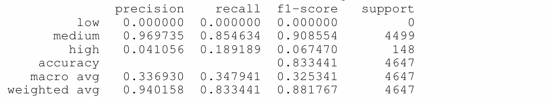
HYPERPARAMETER TUNING ON BASELINE MODEL
Data Science in Practice Project
Best Parameters Found:
Interpretation:
n_estimators = 150
max_depth = 10
class_weight = balanced
The tuned model becomes more sensitive to the minority class.
High-magnitude recall increases from 0 to ~19%, showing the effect of class weighting.
However, overall accuracy drops to ~83% and medium-class errors increase, indicating an aggressive shift in the decision boundary.

Slide 17

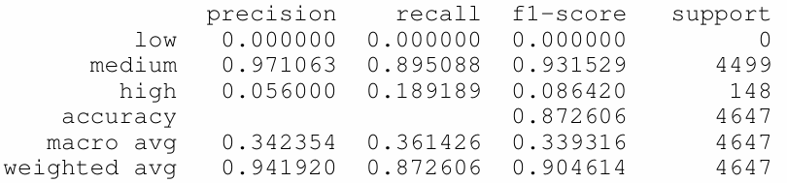
Data Science in Practice Project
HYPERPARAMETER TUNING ON SMOTE-AUGMENTED DATA
Best Parameters Found:
Interpretation:
n_estimators = 150
max_depth = None
class_weight = balanced
Tuning + SMOTE produces the most stable and reliable classifier.
High recall remains ~19%, but medium-class performance is restored compared to the pre-SMOTE tuned model.
This model strikes the best trade-off between accuracy and minority-class detection.

Slide 18
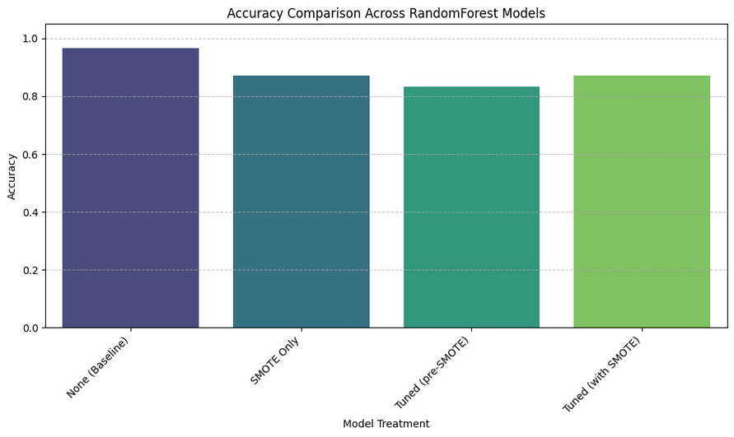
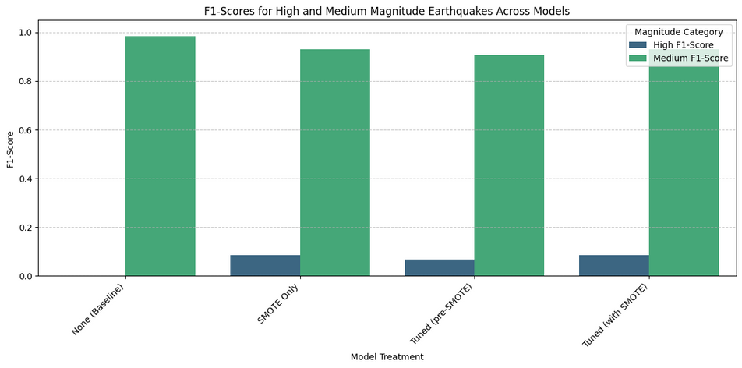
Data Science in Practice Project
F1-SCORE & ACCURACY COMPARISON
Accuracy:
The baseline model shows the highest accuracy, but this is misleading because it predicts only the majority class.
All models that attempt to detect high-magnitude earthquakes show lower accuracy, reflecting the trade-off between overall accuracy and minority-class detection.
F1 Score:
High F1-scores for the medium class across all models indicate stable performance for the dominant class.
The high-magnitude F1-score remains low across all treatments due to rarity of events, but improves only in SMOTE-based models.
The tuned SMOTE model offers the best balance, preserving strong medium-class F1 while slightly improving high-class F1.

Slide 19
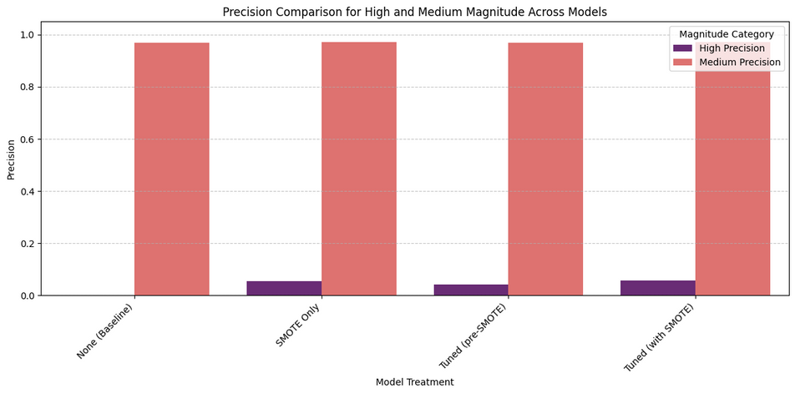
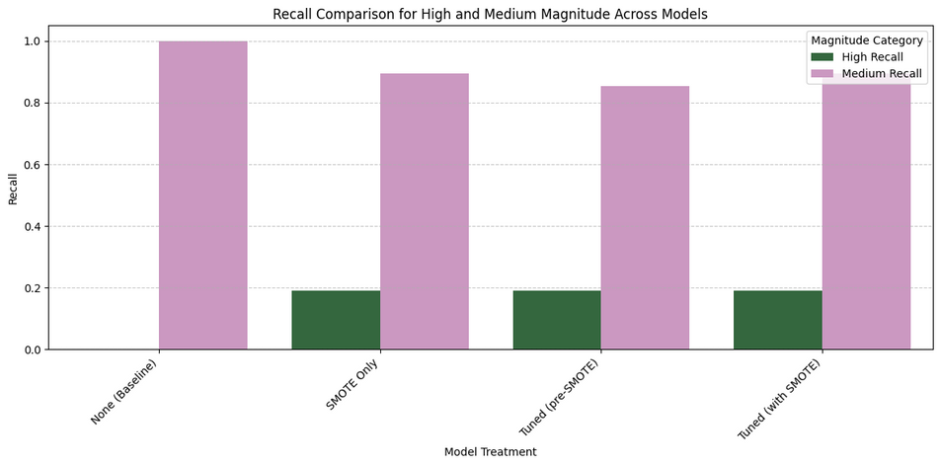
Data Science in Practice Project
PRECISION & RECALL COMPARISON
Precision:
Precision for the high-magnitude class remains low across all models because rare-event detection leads to more false positives.
SMOTE increases the model’s tendency to predict high-magnitude events, which increases sensitivity but lowers precision.
Medium-class precision stays consistently high across all treatments, showing that the models remain reliable for the dominant class.
The tuned SMOTE model maintains strong medium precision while slightly improving high-class precision compared to the pre-SMOTE tuned model.
Recall:
High-magnitude recall improves dramatically from 0% in the baseline model to around 19% when SMOTE is used, showing the model is finally able to detect rare events.
The pre-SMOTE tuned model and SMOTE-only model achieve similar recall for the high class, but with different levels of stability.
Medium-class recall decreases slightly in the SMOTE-only and tuned pre-SMOTE models due to the expansion of the high-class decision boundary.
The tuned SMOTE model restores medium recall while preserving improved high recall, making it the most balanced option.

Slide 20



Data Science in Practice Project
CONCLUSION
Earthquake patterns clearly follow global tectonic plate boundaries, especially around the Pacific Ring of Fire.
Visualizations and heatmaps effectively highlight major seismic hotspots and reveal strong regional clustering.
K-Means successfully identified four distinct seismic zones that match known geological structures.
The baseline Random Forest model showed high accuracy but completely failed to detect high-magnitude earthquakes due to severe class imbalance.
Applying SMOTE and hyperparameter tuning significantly improved the model’s ability to identify rare high-magnitude events, offering a more balanced and risk-focused prediction approach.

Slide 21


Data Science in Practice Project
THANK YOU

